Slide 1
Azure Functions
Introduction to Azure Functions

Slide 2
Azure serverless compute
It’s now becoming easier than ever to create small, targeted microservice architecture using a variety of services
Azure provides many services that can help you achieve a low-friction, high-throughput and low-cost solution
Azure Functions is the newest service in the serverless architecture family

Slide 3
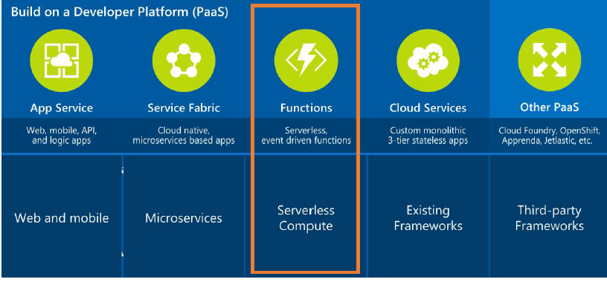
Azure Application Platform

Slide 4
What is Azure Functions?
Azure Functions are a serverless, event driven experience that extends the existing Azure App Service platform
Azure Functions are “nanoservices” that can scale based on demand (only paying for the resources you use)
Think of Azure Functions as…

Slide 5
What is Azure Functions?
• Serverless
Don’t worry about the infrastructure and provisioning of servers, especially when your Functions call rate scales up
• Accelerate development
Write your code in the portal for immediate execution
Quickly and easily iterate with continuous deployment (Visual StudioTeam Services, GitHub, BitBucket)
• Bind into services
Easily add bindings to Azure services and external services (Box, DropBox, OneDrive, SendGrid, …) to get input into or output from yourAzure Functions

Slide 6
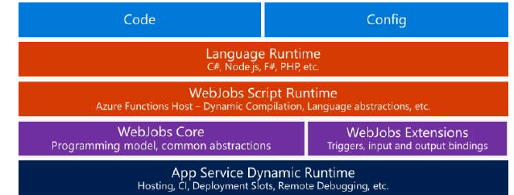
Azure Functions architecture
Azure Functions are built on top of Azure App Service and WebJobs SDK.

Slide 7
What can I do with Azure Functions?
Azure Functions are great for processing data, integrating systems, working with IoT, simple API’s and microservices
Azure Functions provide templates for a number of key scenarios
Azure Functions supports
Triggers - a way to start execution
Bindings - a way to simplify code for input and output of data

Slide 8
INTEGRATIONS
Azure Functions can be triggered by virtually any event in Azure, other 3rd party services or even from on-premise systems
These services can trigger your function (startup) or serve as input and output for your code
Supported Integrations
DocumentDB
Event Hubs
Mobile Apps (tables)
Notification Hubs
Service Bus (queues, topics)
Storage (blob, queues, tables)
GitHub (webhooks)
Twilio (SMS messages)
On-premises (using Service Bus)

Slide 9
Available trigger templates
BlogTrigger
EventHubTrigger
Generic webhook
GitHub webhook
HttpTrigger *
QueueTrigger
ServiceBusQueueTrigger
ServiceBusTopicTrigger
TimerTrigger
* Every function type with the exception of the HttpTrigger type will require a storage account.

Slide 10
Securing your Azure Functions
HttpTriggers can be protected by Oauth providers such as:
Azure Active Directory
Microsoft Account
Facebook
Google
Twitter

Slide 11
DEMO
Requirement
Visual studio 2019 , 2017
Azure portal Account

Slide 12
Approach to building functions
When building your Azure Functions consider this…
“A key to realizing the full value is to write only the smallest unit of logic to do a single scope of work and to keep the dependencies to a minimum.”

Slide 13
Best practices
Functions should “do one thing”
Functions should be idempotent
Functions should finish as quickly as possible

Slide 14
Two kinds of pricing plans
Consumption plan
When your function runs, Azure provides all of the necessary computational resources. You don't have to worry about resource management, and you only pay for the time that your code runs.
App Service plan
Run your functions just like your web, mobile, and API apps. When you’re already using App Service for your other applications, you can also run your functions on the same plan at no additional cost.

Slide 15
Summary
With Azure Functions, the focus is on the code and not managing the infrastructure.
Azure Functions are a key ingredient to serverless compute that is often required for the benefits of PaaS implementations.

Slide 16
Several key benefits
When used as the serverless compute component of a serverless architecture, you have the following benefits:
Reduced time to market
Lower total cost of ownership
Pay per execution

